Slide 1


Nott-A-Code: Project Based Programming Competition
Title: Food Ordering Chatbot
Team Name: TZG Team
Leader/Member: Ter Zi Guan
Programming Language: Python 3

Slide 2

Slide Contents
Flowchart of chatbot design process
Flowchart of chatbot order process
Improvement of chatbot
Improvement example

Slide 3
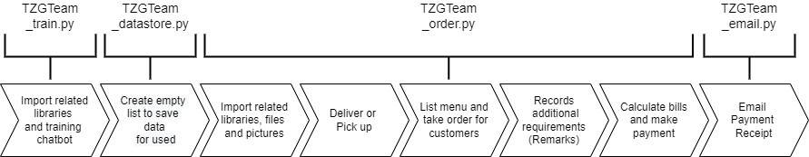

Flowchart of Chatbot Design Process

Slide 4
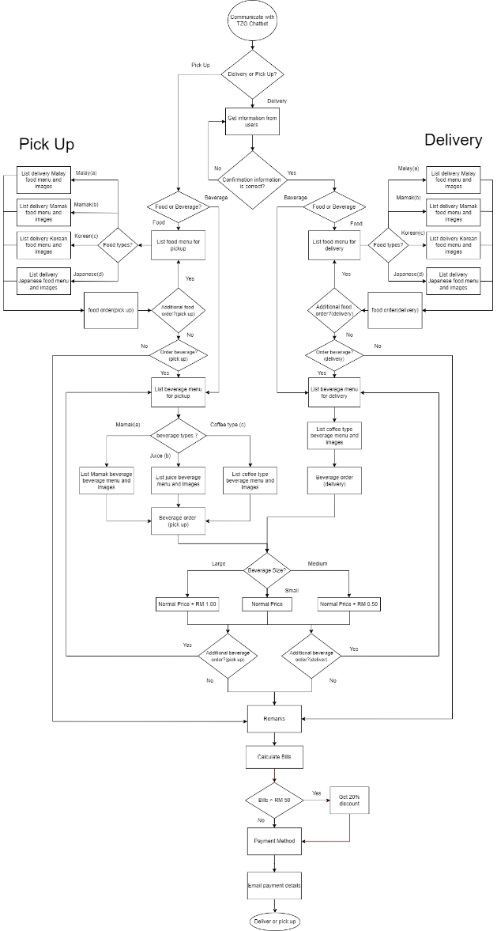

Flowchart of Chatbot Order Process

Slide 5

Improvement of Chatbot
 | Preliminary Round | Final Round
Coding Comments | Explain Too brief | Explain more details
Interaction | Lacking Interaction | More Interaction
User Guidelines | None | Build “help” function
Email Receipt | Less Information | Information more details
Order Procedure | Less User Friendly | More User Friendly
Item Quantity | None | Easily Add Item

Slide 6
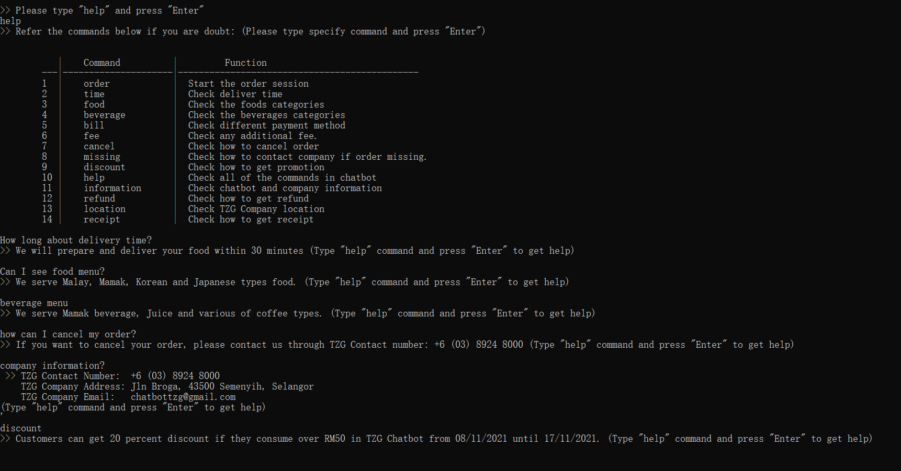
Interaction and “help” function Example

Slide 7
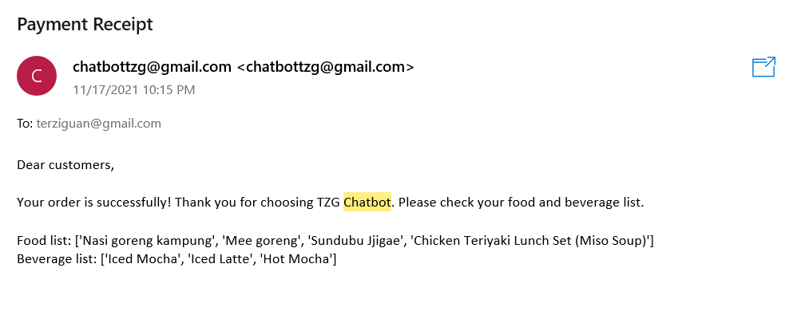
Email Receipt Example (Preliminary Round)

Slide 8
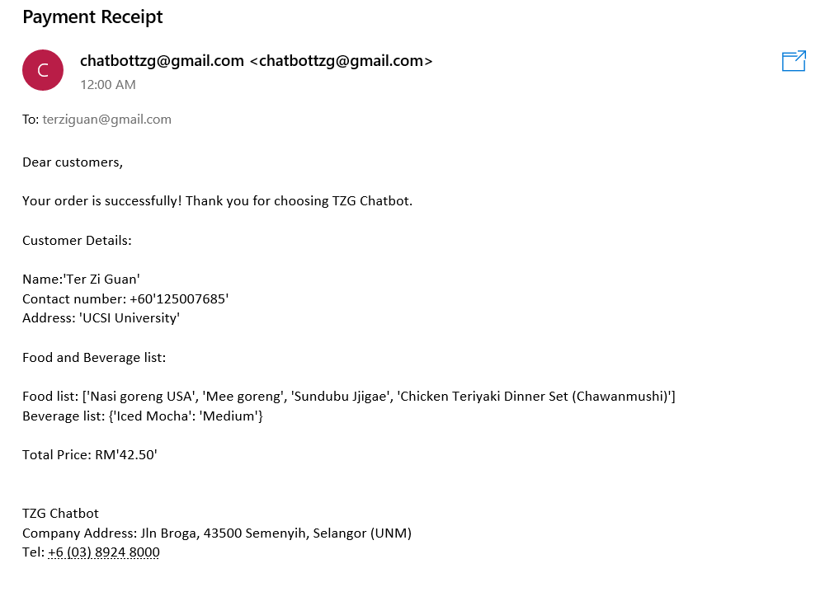
Email Receipt Example (Final Round)

Slide 9
Now , Let us run TZG Chatbot program !!!!

